Slide 1

Python Laboratory project pong game team – 6 semester - III
Team members:
G. Abhinaya (22H51A6717)
G. Chaitanya Sravanthi (22H51A6718)
K. Vishwas (22H51A6723)
Guided by:
Mrs. U. Hemalatha – Asst. Professor

Slide 2
Contents
Problem Definition
​Design components
Method of implementation
Source Code
Output​

Slide 3
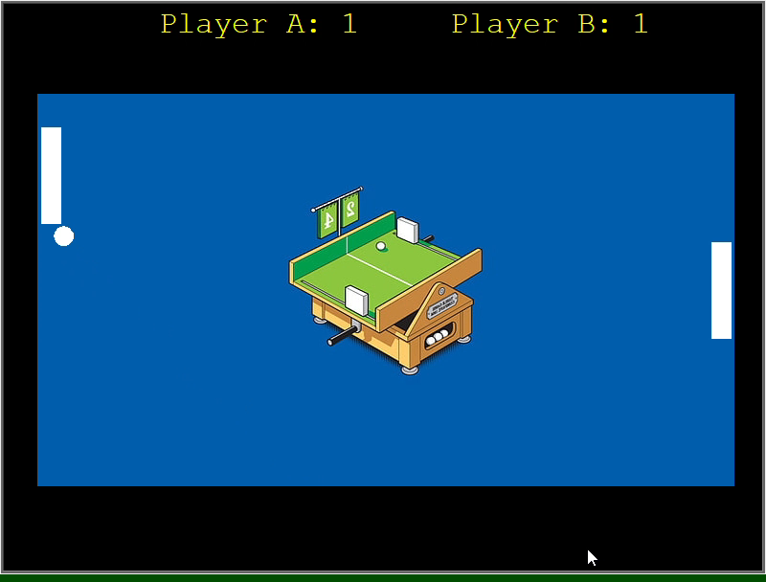
Problem Definition
Pong is a classic arcade game that represents early video game simplicity. In Pong, players control paddles to bounce a ball back and forth, trying to score points when their opponent fails to return the ball. The game's simple mechanics and competitive nature have made it a lasting and iconic part of gaming history.
The challenge at hand is to develop a Python-based recreation of the classic Pong arcade game, encompassing various aspects of game development, graphics programming, and user interaction. The primary goal is to transform the timeless Pong experience into a modern Python application while emphasizing key learning objectives.

Slide 4
Design components:
Paddles and Ball: Create graphical representations of paddles and a ball using the Turtle graphics library.
User Interface: Implement user controls for paddle movement using keyboard inputs.
Score Display: Design a visual display for tracking and presenting player scores.
Sound Effects: Integrate sound effects using the Winsound library for scoring events and paddle-ball collisions.

Slide 5
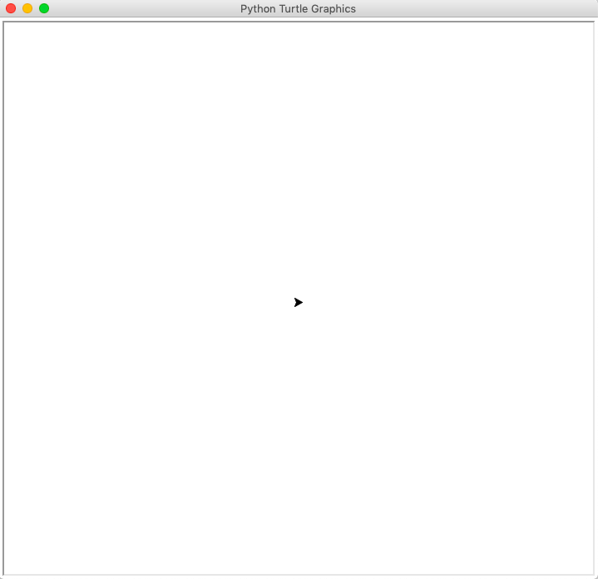
Method of implementation:
We’ve implemented our game using the turtle library that is pre-installed as part of standard python installation.
Turtle graphics is a popular introductory graphics library in Python - “turtle” (a little robot with a pen)
It provides a simple and interactive way to create graphics and drawings. The concept is based on a metaphor of a turtle moving around the screen, leaving a trail as it moves.
We’ve used:
1. Turtle Object Creation: Turtles are created to represent graphical elements like paddles, ball, and text.
2. Turtle Graphics Window (Screen): The main turtle graphics window is created with turtle.Screen().
3. Turtle Movement and Drawing: Turtles are used to move and draw on the screen, updating positions.
4. Turtle Appearance Configuration: Turtles' appearances are configured using methods like shape() and color().

Slide 6
5. Text Display with Turtle: Turtles display text on the screen using the write() function.
6. Event Handling with win.listen() and win.onkeypress(): listen() enables the window to listen for keyboard inputs, and onkeypress() binds functions to keys.
7. Continuous Screen Update with win.update(): The update() function is used to continuously update the screen for smooth graphics.
To enhance the gaming experience, we integrated external libraries such as winsound and time.
The winsound library played a pivotal role in introducing sound effects, triggering audio feedback during scoring events and paddle-ball collisions. This auditory layer contributed to a more immersive gameplay atmosphere.
Additionally, the time library was employed to manage timing aspects, introducing deliberate delays for visual effects, particularly during the countdown sequence at the beginning of the game.
Deliberate pauses during the countdown sequence, achieved with time.sleep(), not only served a functional purpose but also contributed to the overall aesthetics of the game, providing players with a visually appealing and well-paced introduction to the gameplay.

Slide 7
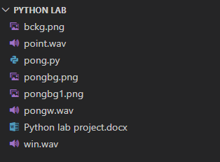
Source Code

Slide 8
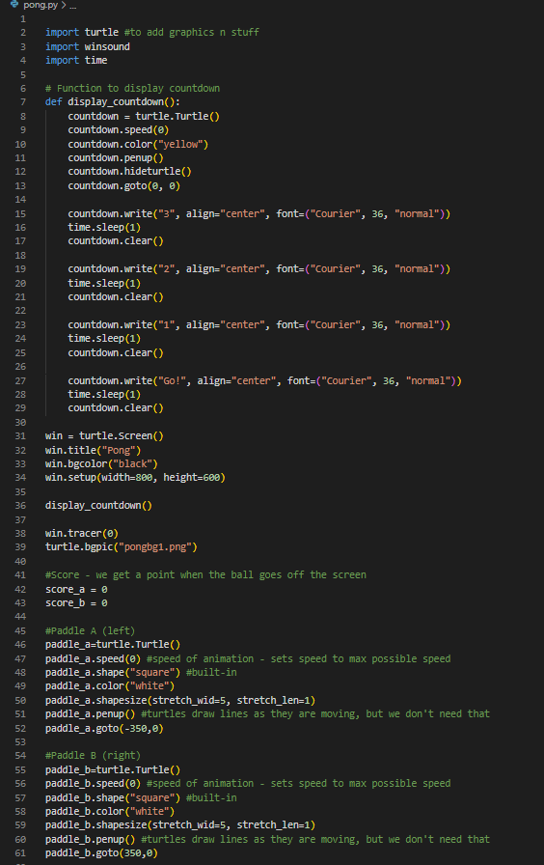
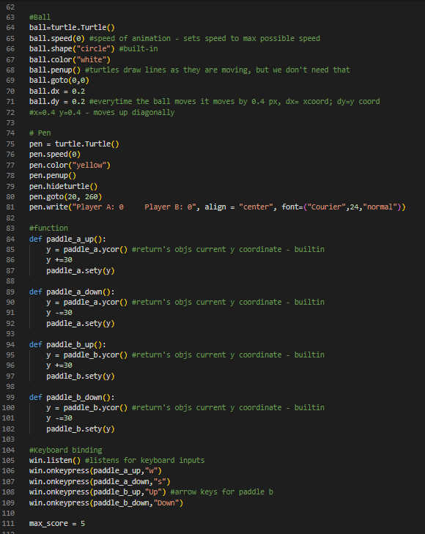
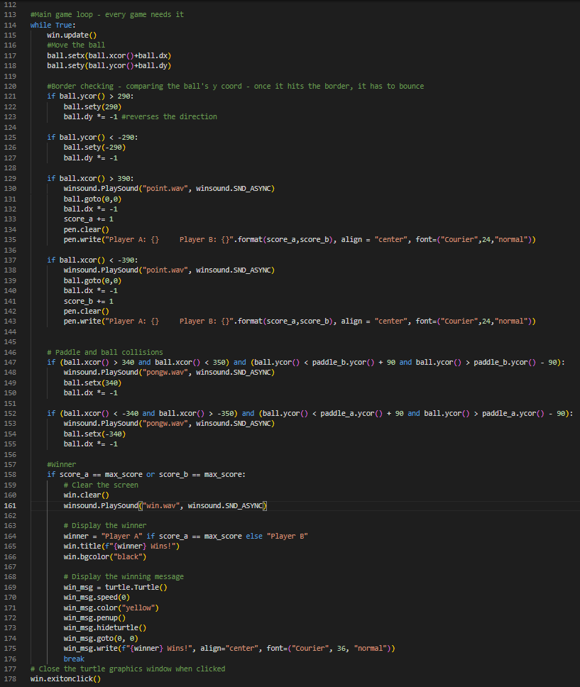

Slide 9
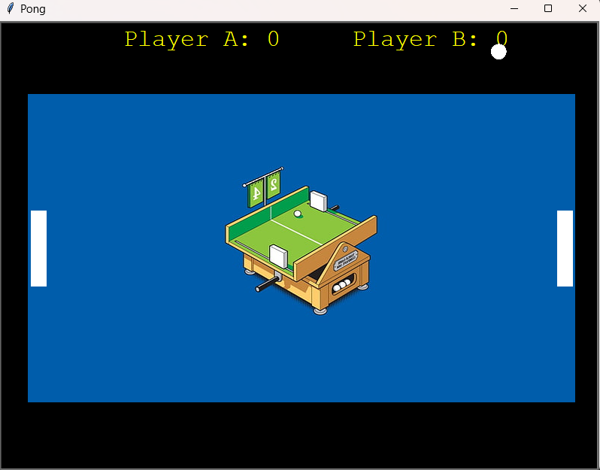
Output

Slide 10
THANK YOU!

